Slide 1
5.6 More on POLYNOMIALS
ALGEBRA CONCEPTS

Slide 2
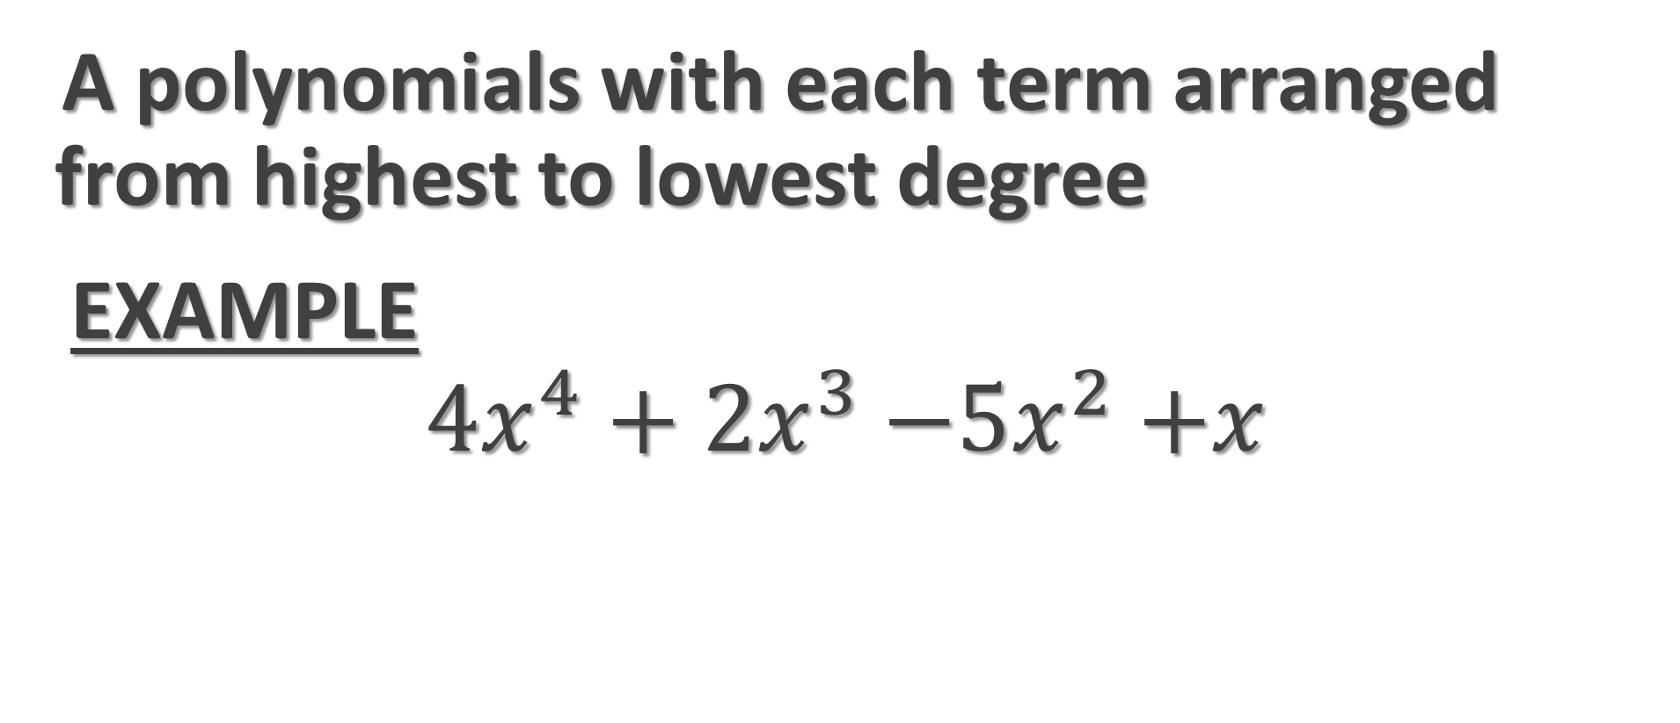
Descending Order
A polynomials with each term arranged from highest to lowest degree
  EXAMPLE
  $${4x}^{4}+{2x}^{3}{−5x}^{2}+x$$

Slide 3

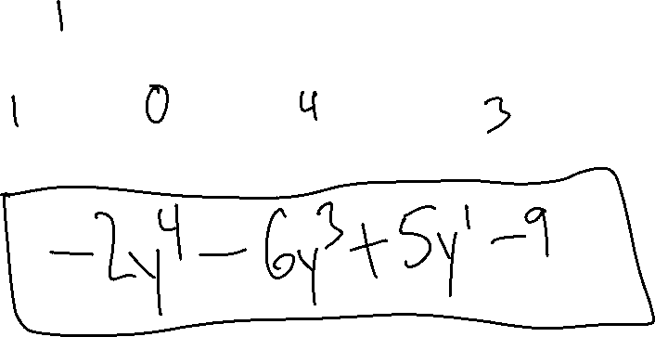
Ex.1) Arrange in Descending Order
$$5y −9−2y^{4}−6y^{3}$$

Slide 4

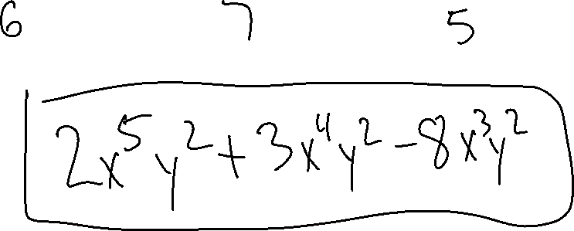
Ex.2) Arrange in Descending Order
$$3x^{4}y^{2}+2x^{5}y^{2}−8x^{3}y^{2}$$

Slide 5

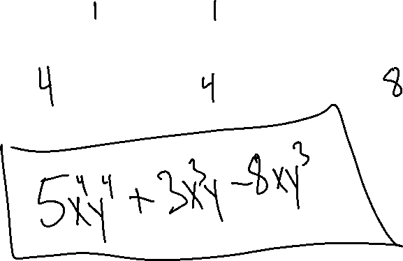
Ex.3) Arrange in Descending Order
$$3x^{3}y−8xy^{3}+5x^{4}y^{4}$$

Slide 6
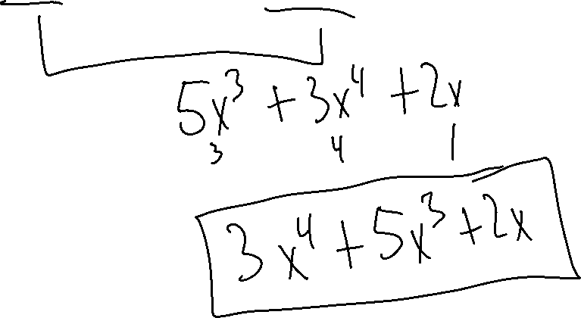
Ex.4) Collect Like Terms & Put in Descending Order
$${7x}^{3}+{3x}^{4}−{2x}^{3}+2x$$

Slide 7
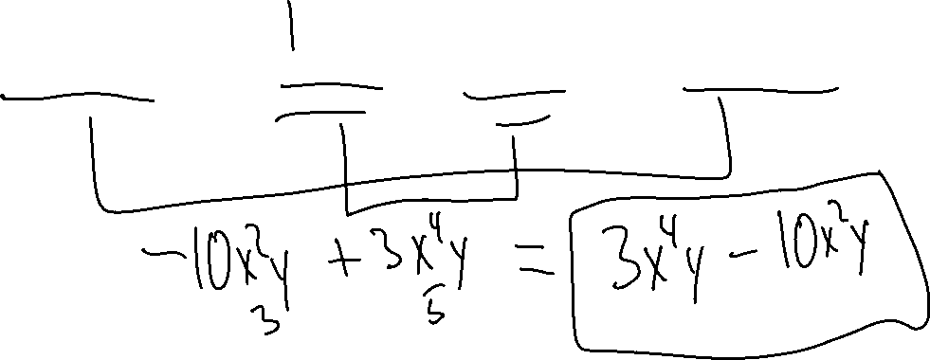
Ex.5) Collect Like Terms & Put in Descending Order
$${−12x}^{2}y+x^{4}y+{2x}^{4}y+2x^{2}y$$

Slide 8
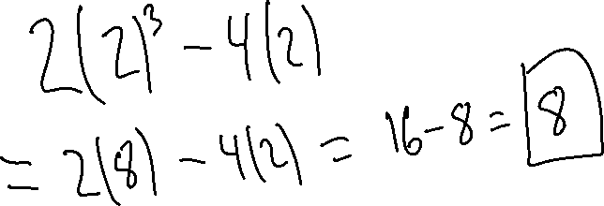
Ex.6) Evaluate The Polynomial
$${2x}^{3}−4x for x=2$$

Slide 9
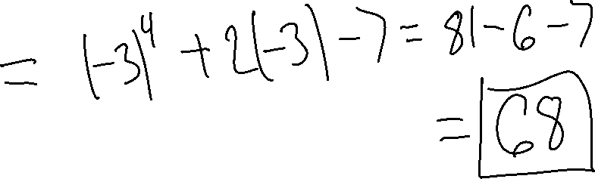
Ex.7) Evaluate The Polynomial
$$x^{4}+2x−7 for x=−3$$

Slide 10
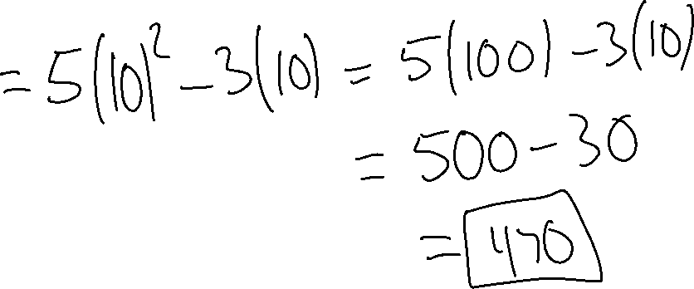
Ex.8) Evaluate The Polynomial
$${5x}^{2}−3x for x=10$$

